Slide 1
Google Cloud Platform
Web Application Deployment

Slide 2
Pre-requisites
Familiarity with Django templates, routing and URLs, views, models
Create Google account, using student email as email address
Collect GCP academic credit, use link in D2L channel and apply credit code to your billing account https://console.cloud.google.com/billing

Slide 3
Pre-requisites
Install GCP SDK Tools https://cloud.google.com/sdk/docs/
Run these commands from the command prompt/terminal:
gcloud init
gcloud components update
gcloud components install app-engine-python

Slide 4



Cloud Service Providers
The cloud = someone else's computer(s)
Set up a web server, database server, storage... on one of your cloud provider's computers, instead of your own
Scalable, elastic, always on, rapid deployment, pay-as-you-go pricing
Removes the need for organizations to manage their own hardware
Economies of scale, delegate admin, maintenance, security etc. to cloud provider
Very, very popular

Slide 5
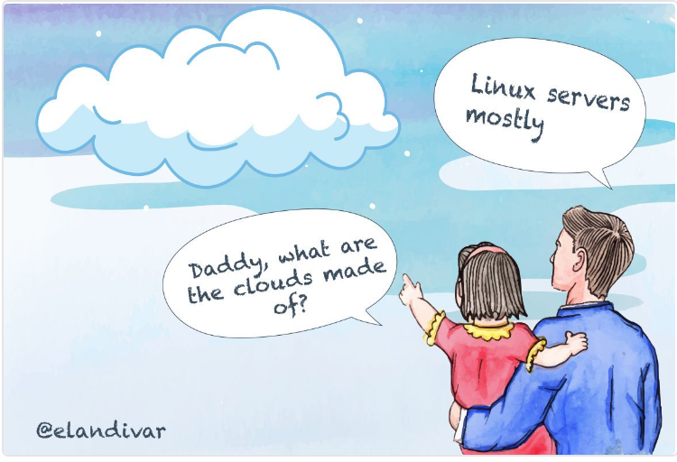
Cloud Service Providers
Computers are virtual machines, usually Linux-based

Slide 6
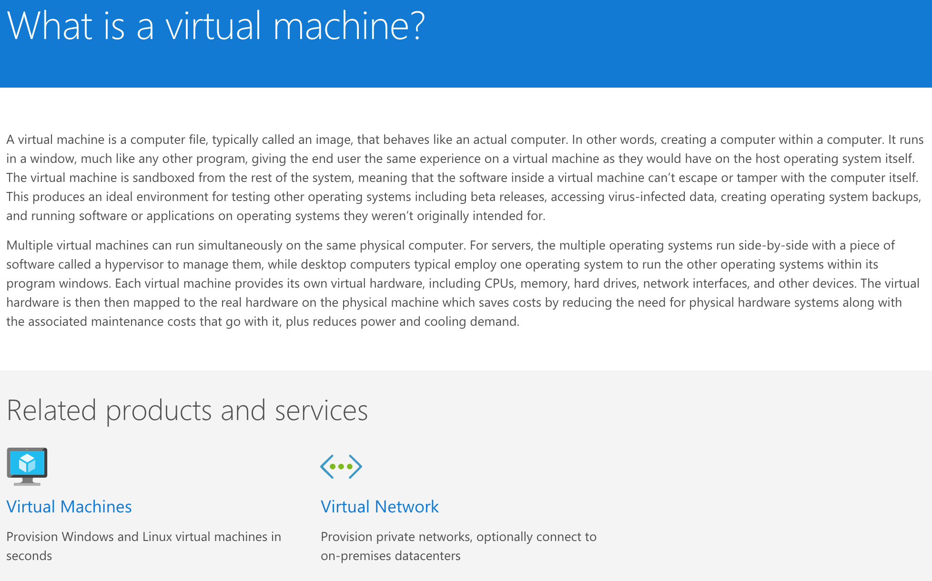
Even Microsoft's Azure uses Linux virtual machines!
https://azure.microsoft.com/en-us/overview/what-is-a-virtual-machine/

Slide 7
Qualities of Cloud Computing
Fast setup - no physical hardware to install and manage
No need to deal with upgrading hardware, patching, maintenance...
Economies of scale - cloud provider can operate 1000s of servers somewhere power is cheap, pass savings to customer https://www.google.com/about/datacenters/
Elastic, scalable
If demand is low, uses only resources needed. If demand increases, can automatically scale (add new virtual servers - instances - and balance load between them) to handle demand; remove/scale down when demand falls
What companies can you think of that don't have consistent requirements for infrastructure?
Billed in a pay-as-you-go model
Only pay for the resources being used

Slide 8
The Cloud
The cloud = someone else's computer(s)
Which has pros and cons
Pros: cheaper, operational benefits, elasticity, scalability, no need to manage hardware, convenient web console access...
Cons: it's someone else's computer; all services can be accessed via browser interface
Essential to keep access credentials secure, have backups in another location
DO NOT UPLOAD CREDENTIALS OR KEYS OR PASSWORDS TO GITHUB
Ensure cloud provider has the ability to store data in compliance with any required regulations, PCI, HIPAA etc.
Various ways for malicious users to exploit cloud services: mining Bitcoin, changing your passwords and demanding a ransom for access...
https://adeliarisk.com/secure-cloud-computing-7-ways-id-hack-aws/

Slide 9

Cloud Service Providers
AWS (Amazon Web Services) is the market leader
Microsoft Azure, IBM Cloud and Google Cloud Platform have around ~15% market share each, but are all growing

Slide 10
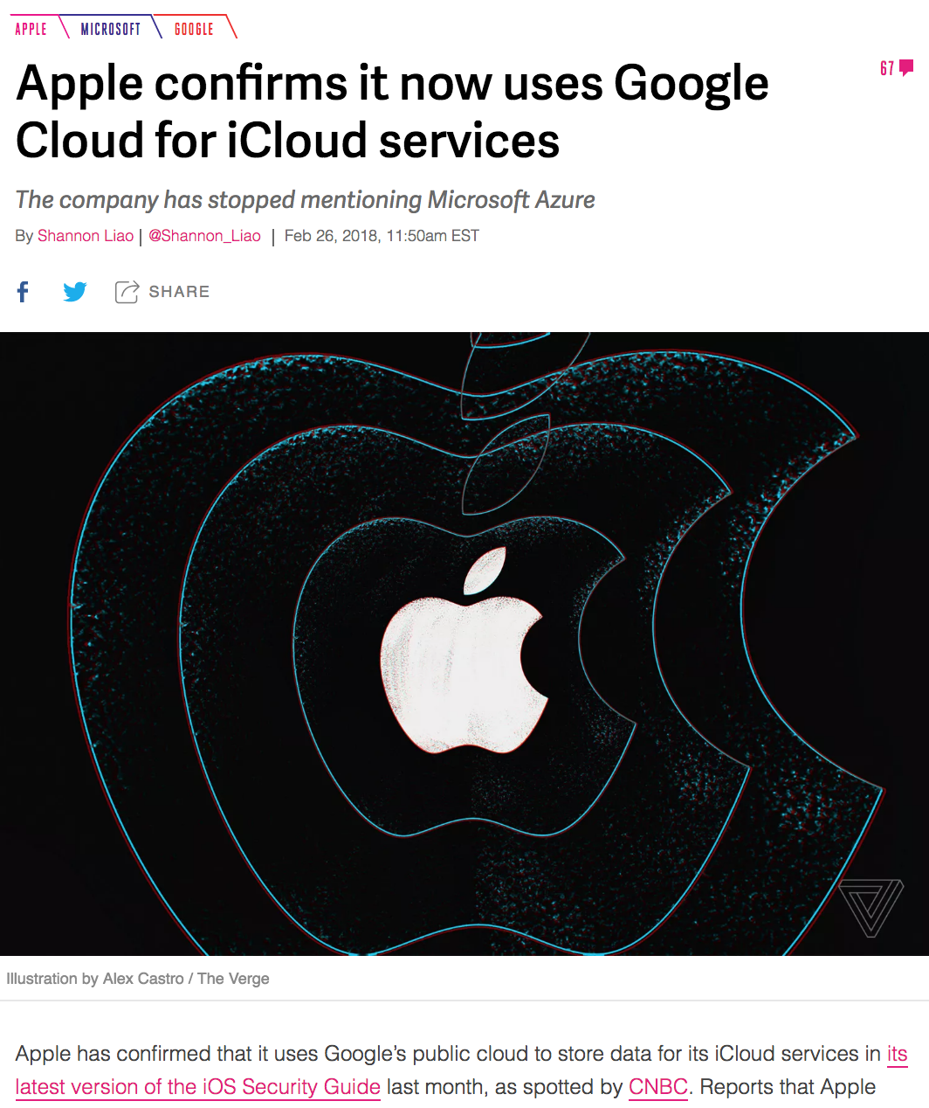
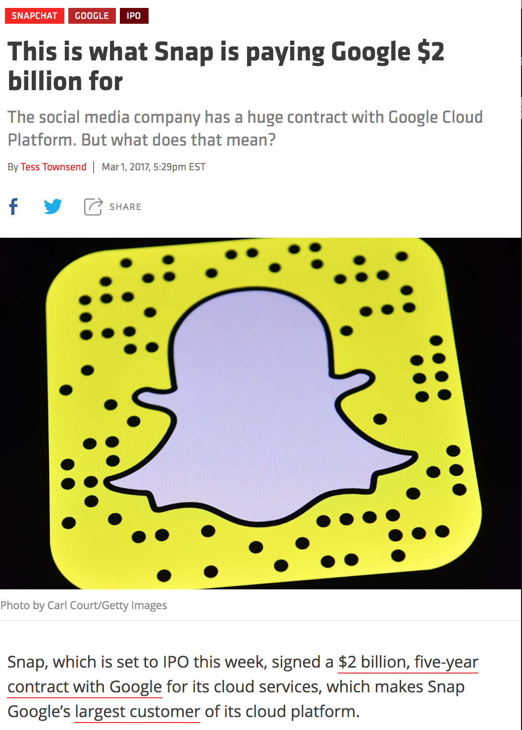
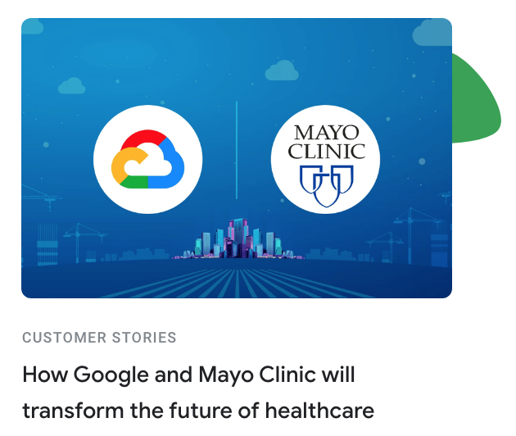
Some GCP Users
Apple
Snapchat
PricewaterhouseCoopers
General Mills
Coca Cola
HTC
Best Buy
Mayo Clinic
https://www.recode.net/2017/3/1/14661126/snap-snapchat-ipo-spending-2-billion-google-cloud
https://www.theverge.com/2018/2/26/17053496/apple-google-cloud-platform-icloud-confirmation
https://cloud.google.com/blog/topics/customers/how-google-and-mayo-clinic-will-transform-the-future-of-healthcare

Slide 11
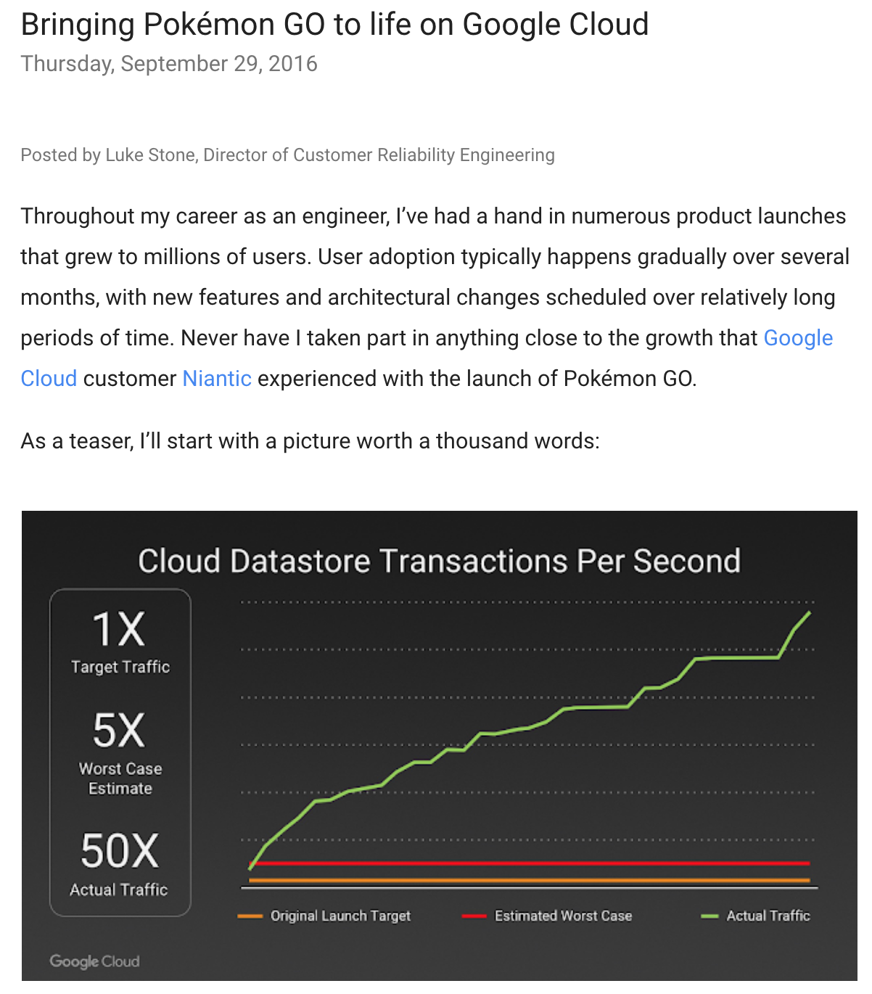
Pokémon GO
https://cloudplatform.googleblog.com/2016/09/bringing-Pokemon-GO-to-life-on-Google-Cloud.html

Slide 12
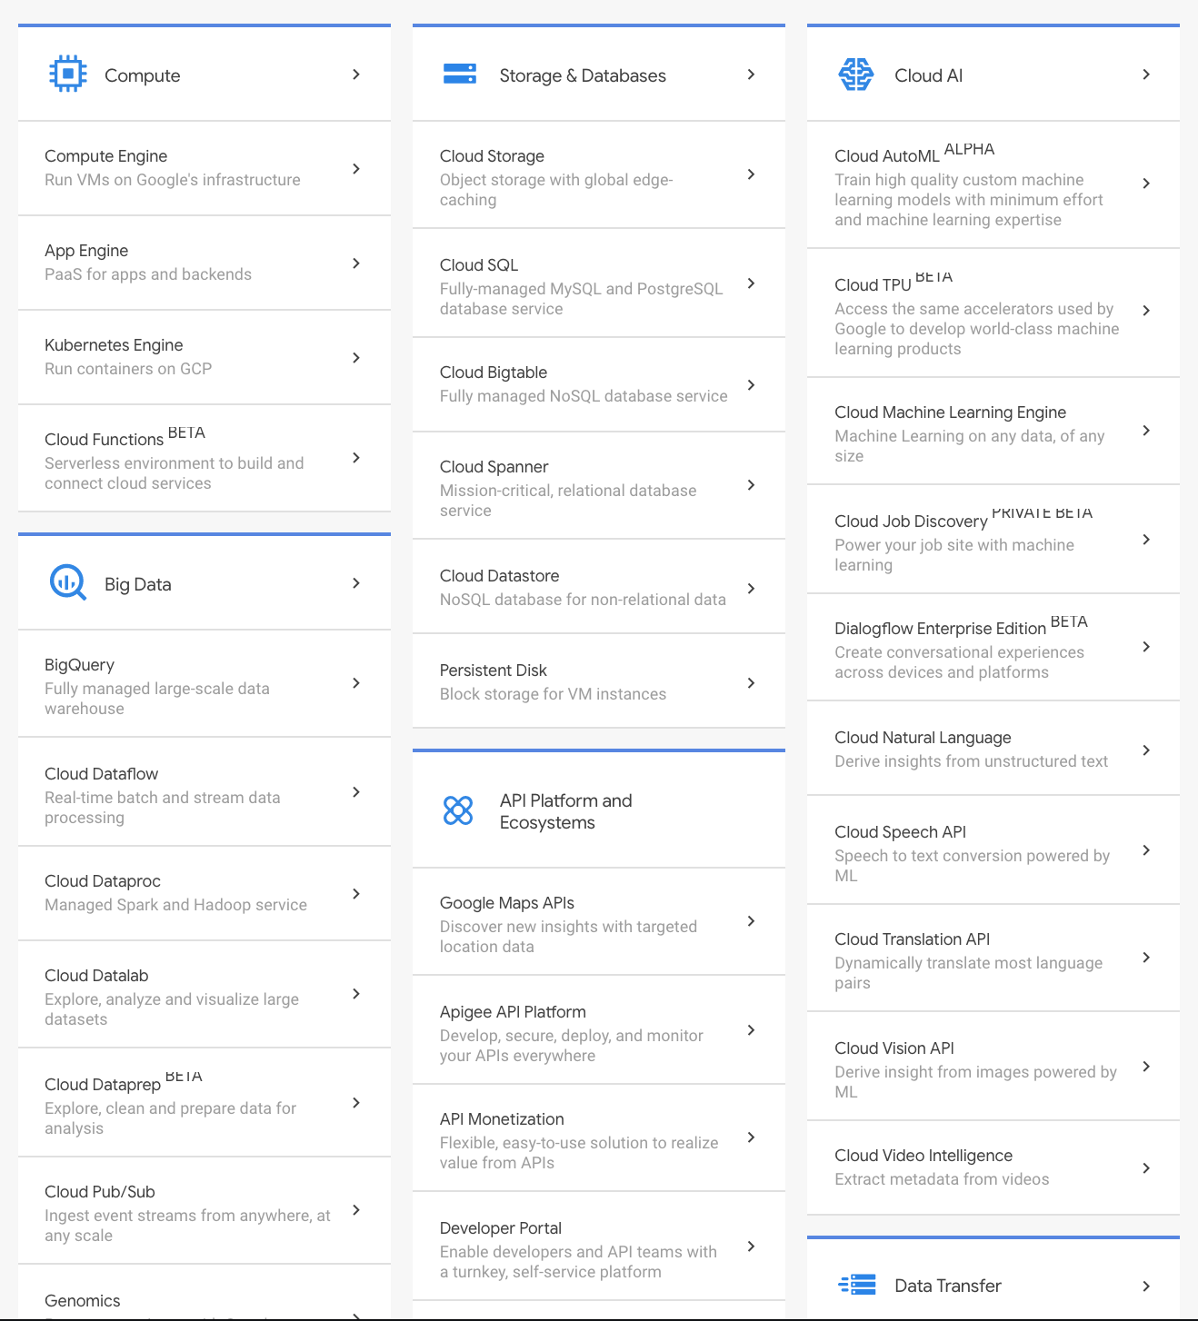
Lots of cloud services....
https://cloud.google.com/products/
We are going to use
App Engine: PaaS web application server host
Cloud SQL, PostgreSQL database
Cloud Storage, storing static files and media in buckets
Logging
Billing - pay attention to this
No-one used their own credit card on their account, right?
And several more.....

Slide 13
App Engine is a PaaS: Platform as a Service
Platform = the (virtual) server that will run your code
Provides a mostly configured virtual web server that you can upload your code to
Many other similar services; Heroku, AWS Elastic Beanstalk, Azure Virtual Machines, Engine Yard...
Some server configuration usually required
Heroku: almost none, GAE requires some config, AWS requires more configuration

Slide 14
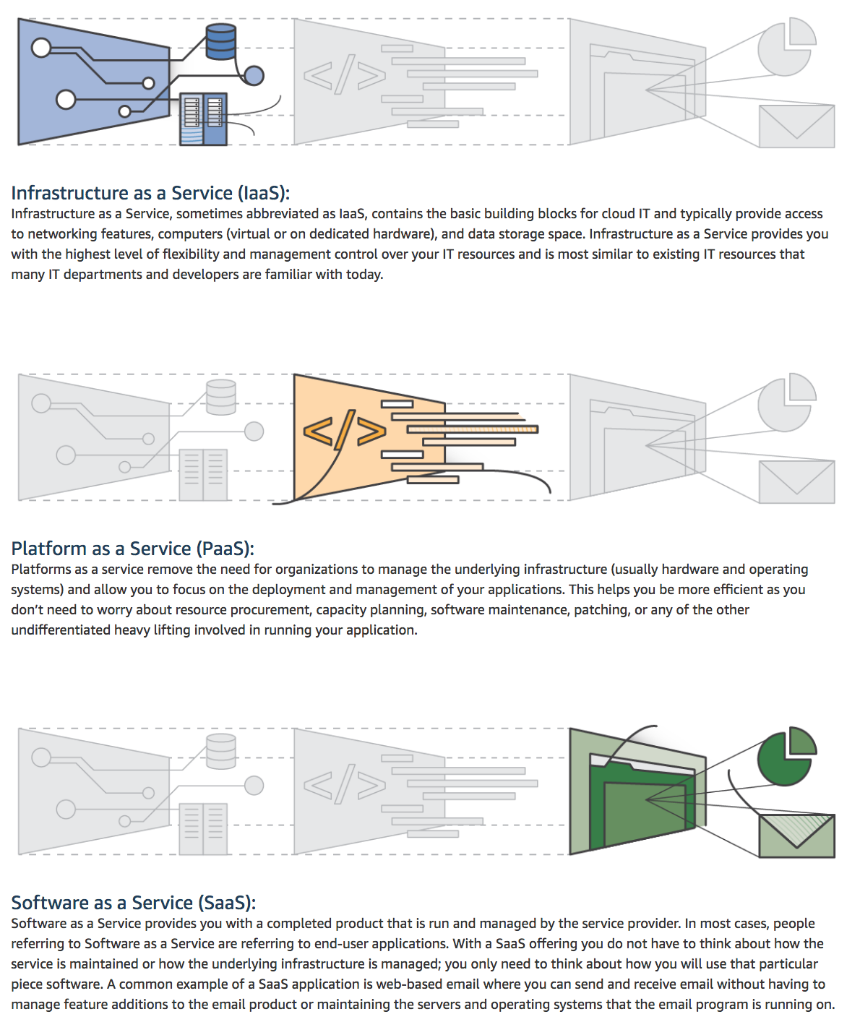
Type of Cloud Computing
There's overlap between these types
You can do some (or no) infrastructure configuration in App Engine and AWS Elastic Beanstalk
Heroku is a PaaS - minimal server configuration, but very fast deploy
IaaS, infrastructure as a service - a bare computer that you install and configure as a web server. More work but more flexible. AWS Elastic Beanstalk has some qualities of IaaS: you do some raw server configuration to get your app running.
There's a lot of blur between PaaS and IaaS. We'll use App Engine's Flexible Environment which has some qualities of IaaS.
https://aws.amazon.com/types-of-cloud-computing/

Slide 15
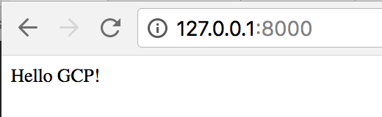
Hello World Django App
Clone simple app from https://github.com/claraj/hello_django_gcp
One page with a message, no database
Install dependencies pip install -r requirements.txt
You don't need to bother with a virtual environment
Verify it works locally
Run with python manage.py runserver
View app at 127.0.0.1:8000

Slide 16
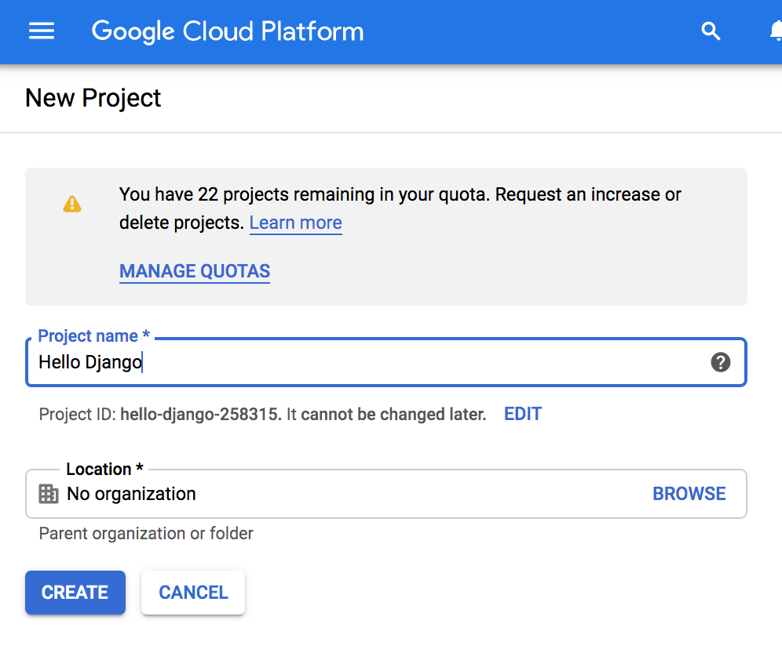
Create a project in GCP Console
https://console.cloud.google.com/projectcreate
Call it Hello Django
Notice a Project ID is generated

Slide 17
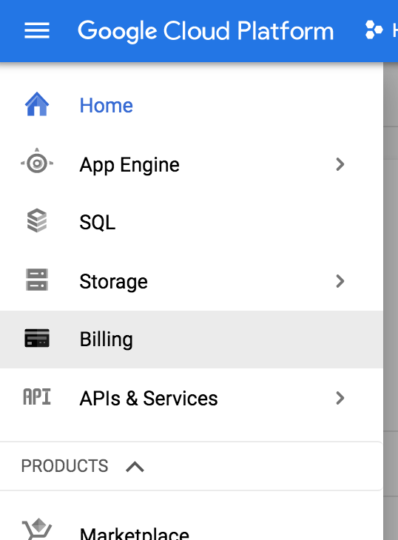
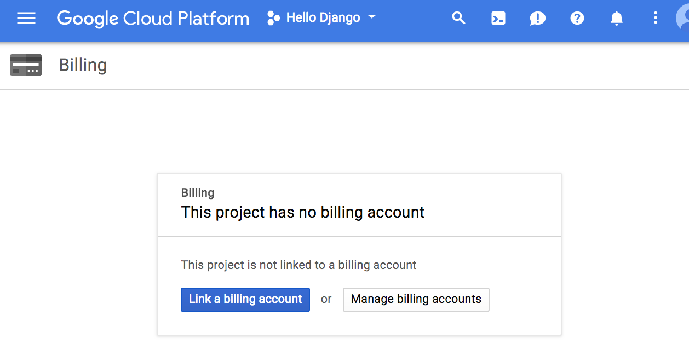
Enable Billing for this project
https://console.cloud.google.com/billing or click on the Billing option in the left menu
Link your billing account that has your academic credit in

Slide 18
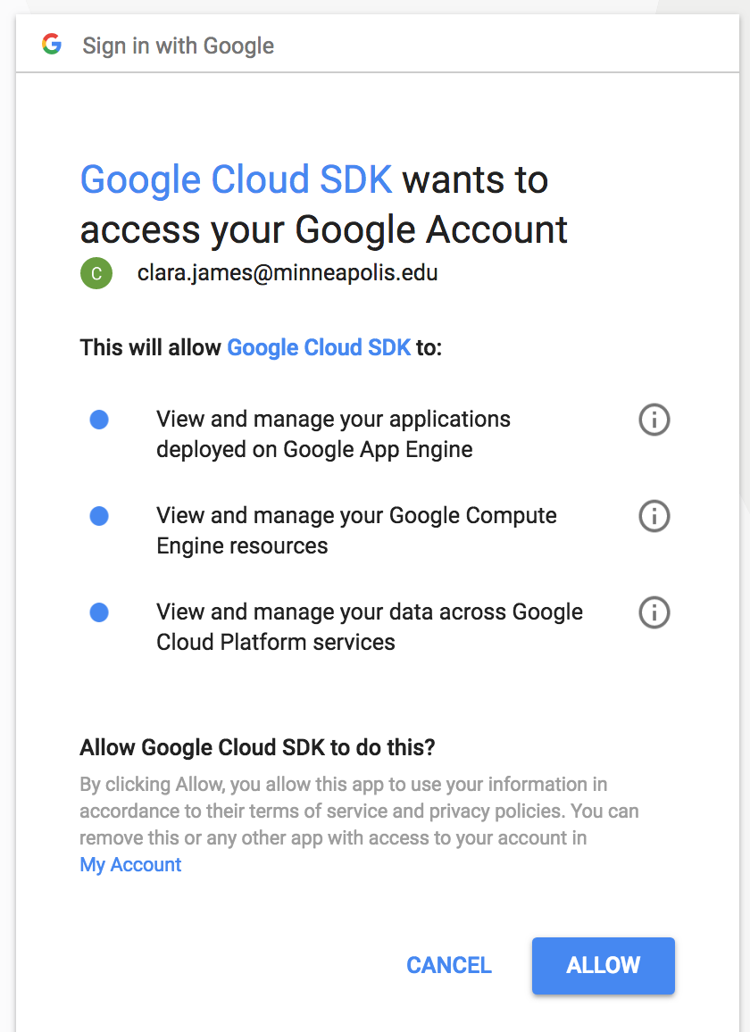
Command Line/Terminal
You should have installed the gcloud tool
Authenticate to GCP so you can deploy/manage your resources from the command line
Type
gcloud auth login
A web browser should open, sign in to your Google account and select 'allow'
Lab/shared computers: run
gcloud auth revoke
to "log out" at the end of your session

Slide 19
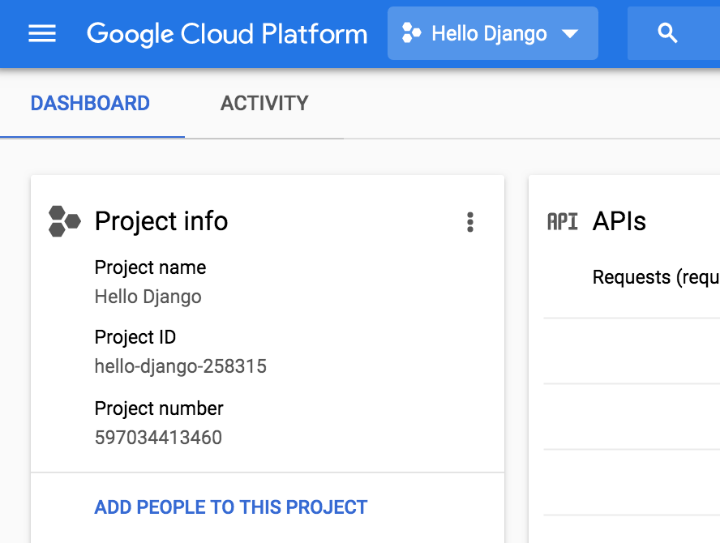
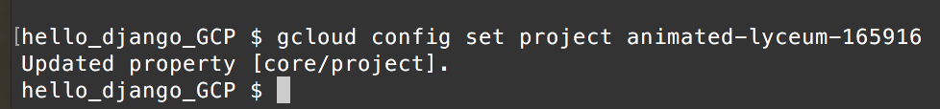
Set current project
gcloud config set project hello-django-123456
But use your own project ID
Forgotten? Run gcloud projects list
or look in the console

Slide 20
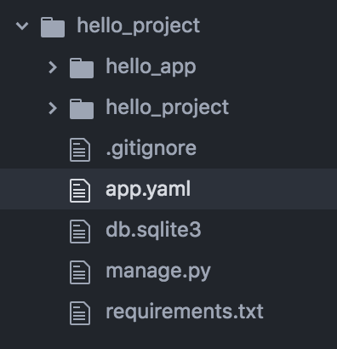
Configuration
All GCP projects require a configuration file called app.yaml
Create this file in the root directory of your project
Same location as requirements.txt and manage.py

Slide 21
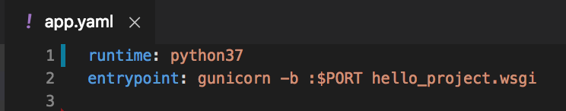
app.yaml
yaml is a markup language, similar purpose to JSON

Slide 22
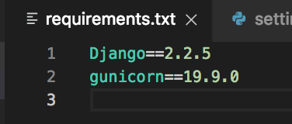
requirements.txt
Verify Django, gunicorn are listed
gunicorn (green unicorn) is a web server
http://gunicorn.org/
For your own apps, make sure this lists all the dependencies the app needs
When it's deployed, GAE will read this file and install the dependencies listed

Slide 23
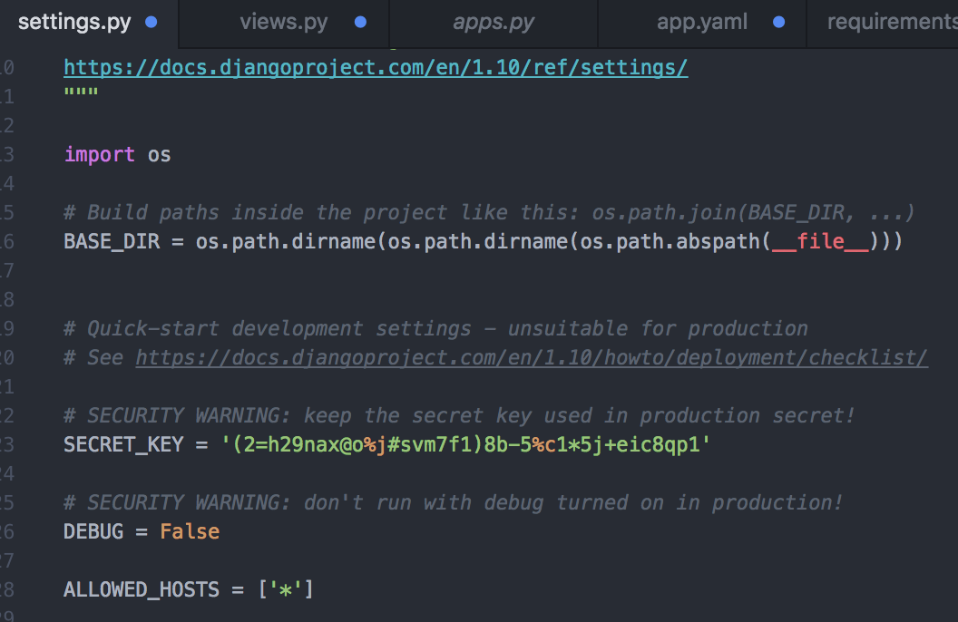
ALLOWED_HOSTS hello_project/settings.py
Set
ALLOWED_HOSTS = ['*']
This is a list of IP addresses that are allowed to visit our site
Optionally set DEBUG = False
We'll look more at development vs. production settings soon

Slide 24
gcloud app deploy
Verify your console/terminal is in the same directory as app.yaml
Begin deployment process with
gcloud app deploy
If error message about no app.yaml, make sure you created and saved app.yaml file in the root directory of your project, and you are running gcloud app deploy from the same directory as that app.yaml file. Press Control+C and try again.

Slide 25
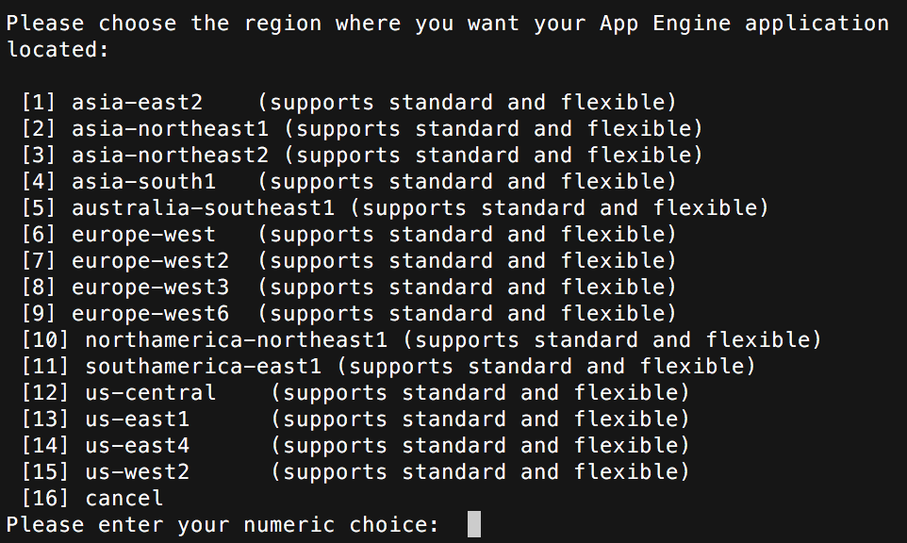
gcloud app deploy: select region
Typically, select the region that's geographically closest to your app's users. Google's Iowa data center, us-central, is closest to Minnesota
Enter number for us-central

Slide 26
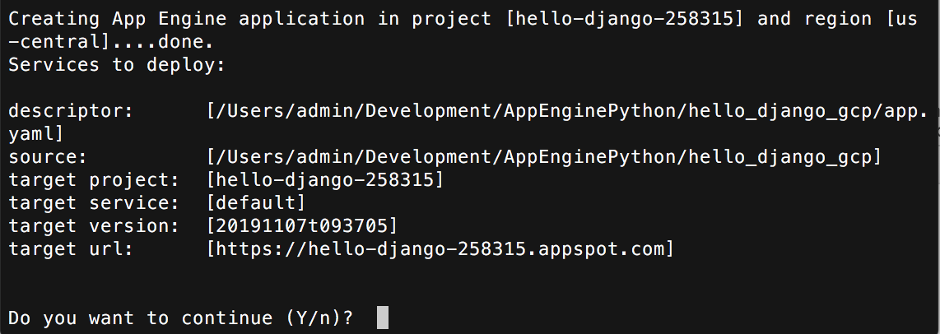
Do you want to continue?
Verify the project id is correct
Type Y

Slide 27
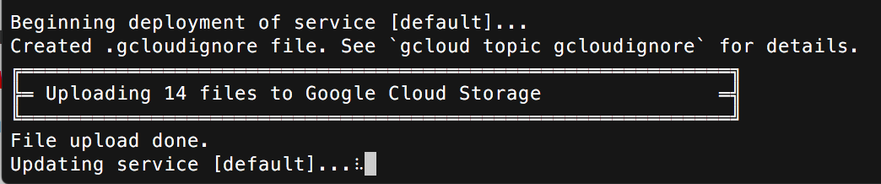
Wait....
It will take several minutes....
Behind the scenes, Google is creating a container for your project, and getting that running
You'll see a lot of console output, but hopefully no errors

Slide 28
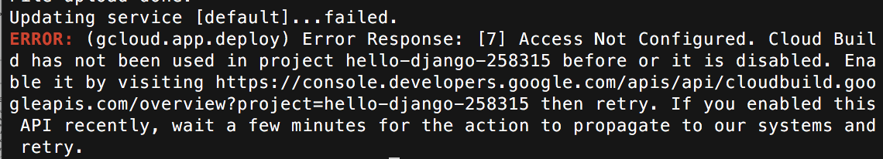
Errors?
Ensure you created a project
Enabled billing for the project and applied your student coupon
Authenticated to gcloud (gcloud auth login)
You have applied your academic credit to your billing account
Created app.yaml in correct place in project
Check app.yaml for typos
settings.py ALLOWED_HOSTS is set to ['*']
You saved everything before you deployed
You'll see this error if no credit

Slide 29
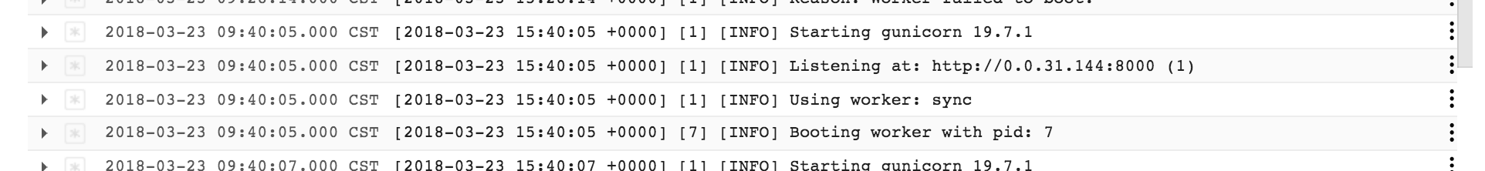
Logs
https://console.cloud.google.com/logs/
In your applications, this is the default location for logging output

Slide 30
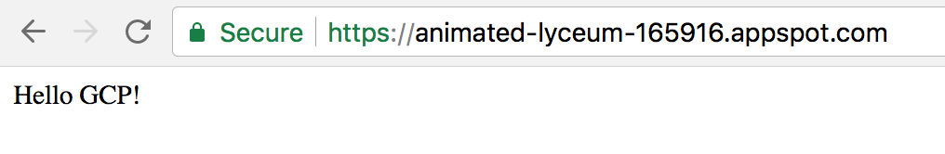
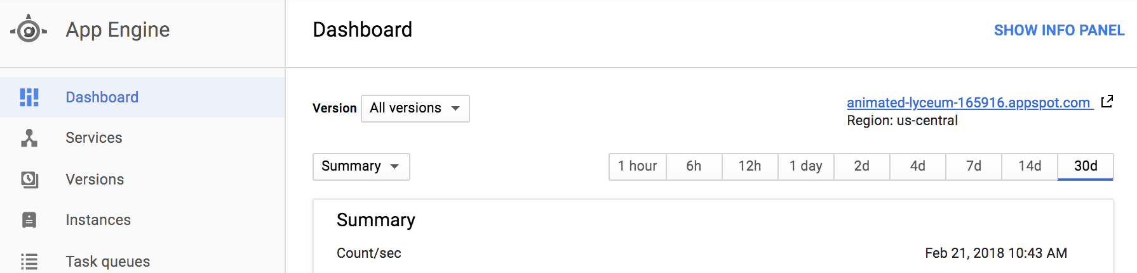
No errors?
Open app with
gcloud app browse
to open your app in a browser
Can also open from gcloud console

Slide 31
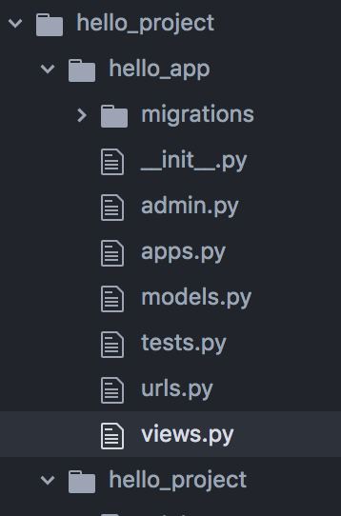
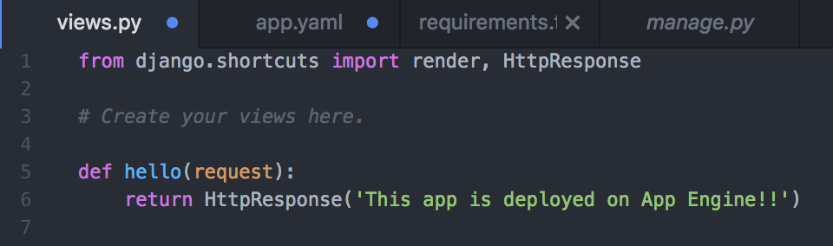
Make update to site
In hello_app/views.py, change the response string
Use any text you like, and save your changes

Slide 32
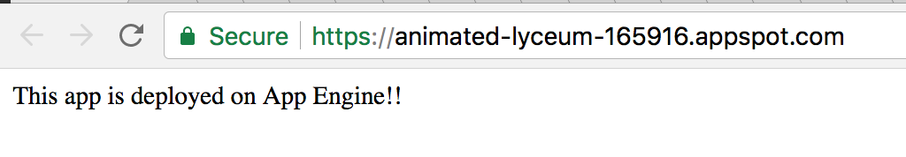
Deploy the new version
gcloud app deploy
Wait....
Open new version of app in browser

Slide 33
STOP
Show me your Hello GAE app running at App Engine for credit for this part of the lab

Slide 34
Standard vs. Flexible
Standard is cheaper and faster to deploy, supports Python 2.7 and 3.7
Good for smaller personal sites
Utilities like Twitter bots, Slack bots... https://github.com/minneapolis-edu/iss_slack_bot ; https://github.com/minneapolis-edu/weather_bot or services/utilities that work on behalf of your app
Has a free tier for smaller apps
Flexible is more.... flexible. Runs whatever version of Python you want, whatever libraries, can provide custom binaries, can write to disk.... More expensive for smaller sites, cheaper for larger sites
When looking at documentation, be sure that you are reading the right version
Standard: https://cloud.google.com/appengine/docs/standard/python3/
Flexible: https://cloud.google.com/appengine/docs/flexible/python/

Slide 35
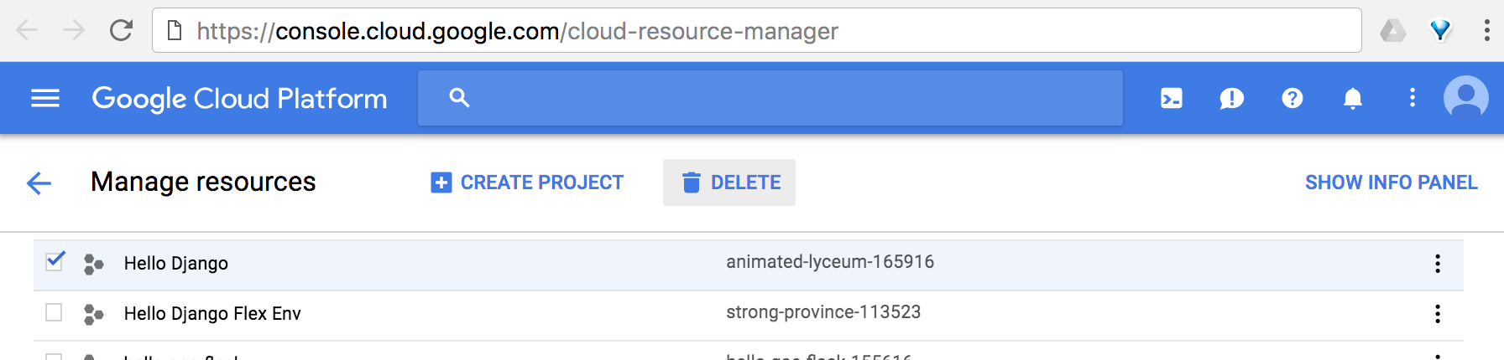
Cleanup
A project can cost money just by existing
Delete it from the Projects Page https://console.cloud.google.com/cloud-resource-manager

Slide 36
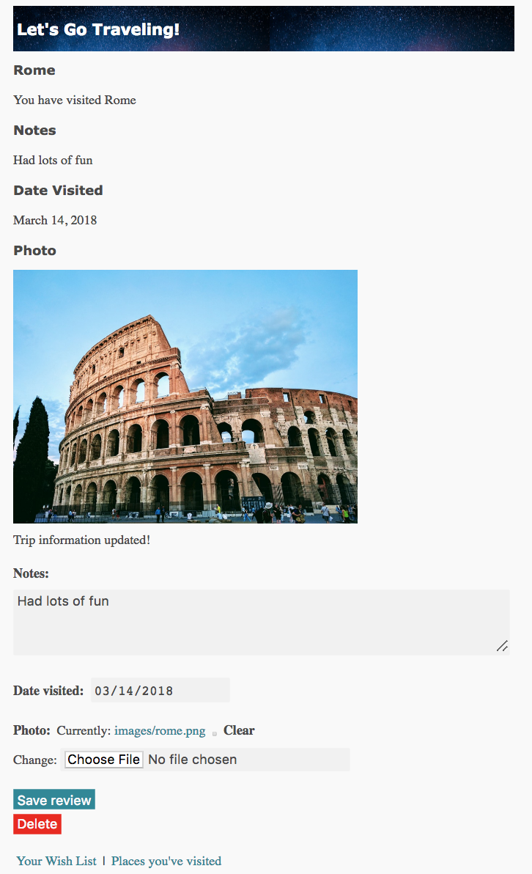
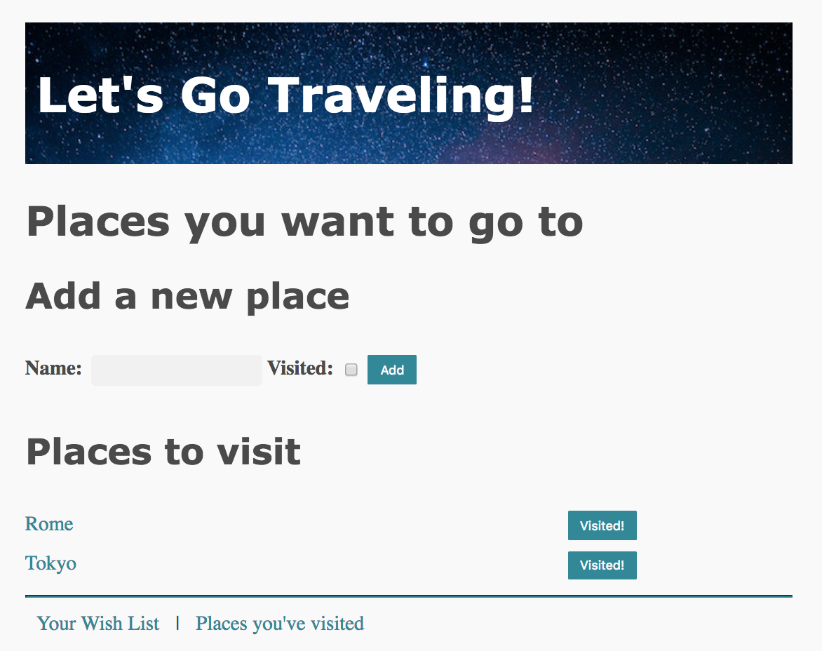
Travel Wish list for App Engine
User can upload a photograph for any place that they have visited

Slide 37
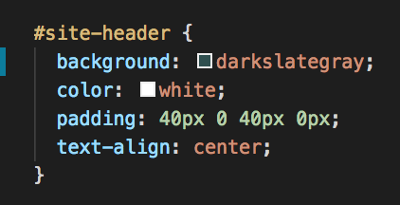
Issues with static images in CSS
Replace the background image with a plain color
Edit the first #site-header style in travel_wishlist/static/style.css
Use any color you like
Here are the color names you can use, or use a hex color
https://www.w3schools.com/colors/colors_names.asp

Slide 38
Travel Wish List
We'll deploy the version with image uploads that you built in lab
If you need a copy, https://github.com/claraj/wishlist_with_uploads
Has image uploads, requires authentication to use
Uses PostgreSQL database
Could use MySQL or another RDB instead, but Django recommends PostgreSQL - various Django features are supported nicely in PostgreSQL

Slide 39
Travel Wish List
So we need several GCP services to for this app
App Engine, to run the code
Cloud SQL, for the database
Cloud Storage, for media files

Slide 40
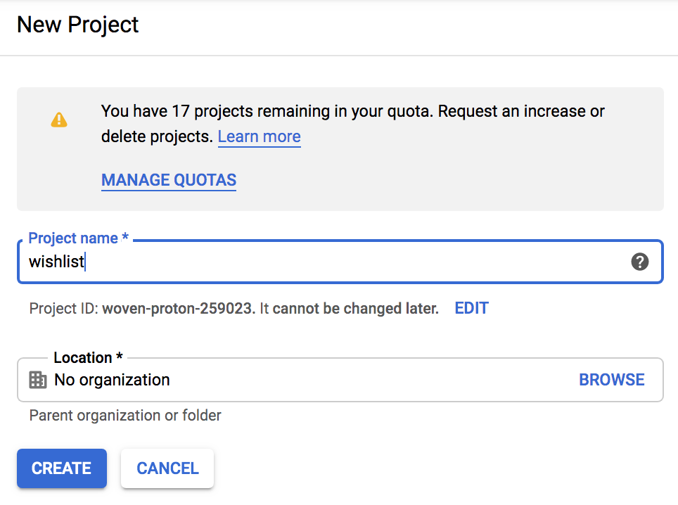
GCP: Create New Project
In GCP, create a new project as before
https://console.cloud.google.com/projectcreate
Give it a name e.g. "Wishlist"
Note the Project ID

Slide 41
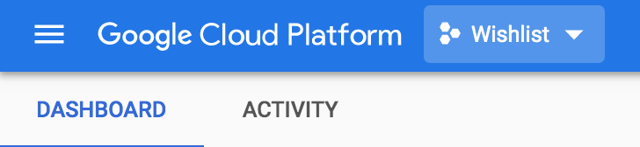
GCP Console
From the home page of the GCP console
https://console.cloud.google.com/
Select your new project

Slide 42
Make sure your command prompt/terminal is in the root directory of your Wish List project
It matters where you run these commands from
GCP assumes all of the code you want to deploy is in the directory you run the commands from

Slide 43
Set Project, replace example ID with your own
Run this command, use your own project ID
gcloud config set project wishlist-id-12345

Slide 44
Verify that code runs locally
If it doesn't run locally, it won't run at App Engine
python manage.py runserver
Go to 127.0.0.1:8000/admin
Log in with your user account
Now should be able to visit site
Also unit tests
python manage.py test
If you cloned the example, you'll need to make migrations and migrate.
And you'll need to create a superuser to access the admin console

Slide 45
Deployment
We need to:
Replace SQLite with PostgreSQL DB
Provide app.yaml configuration file for app so GAE knows how to install dependencies and run the code
Create storage buckets for static file resources and user-uploaded images

Slide 46
Development vs production aka dev vs prod
Development = your local computer aka dev
Production = app deployed to customers, running on GCP aka prod
The environment the app runs in during development is different during production
How? In what ways?

Slide 47
Development vs production aka dev vs prod
Locally, we've been using SQLite. It works very well for development
But SQLite is not suitable for a deployed website - can only support one connection at a time, and lacks many features

Slide 48

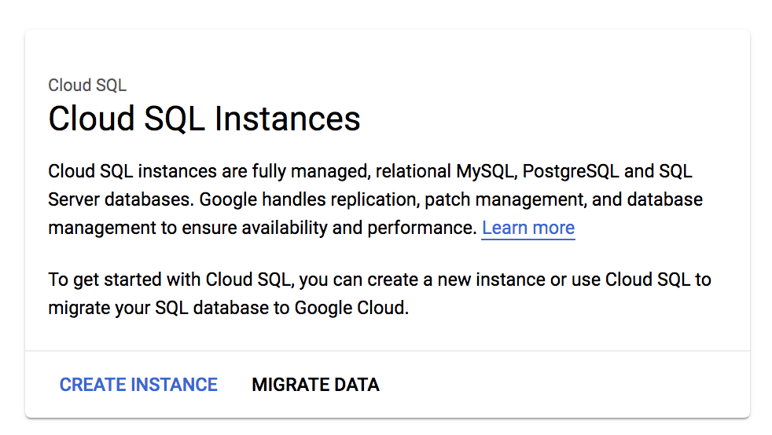
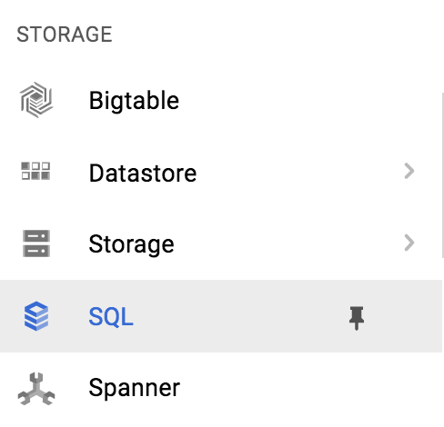
Cloud SQL
Click here to open the menu
In the menu, select SQL from the Storage section
Click Create Instance
You can pin services to the top of the menu if you like

Slide 49
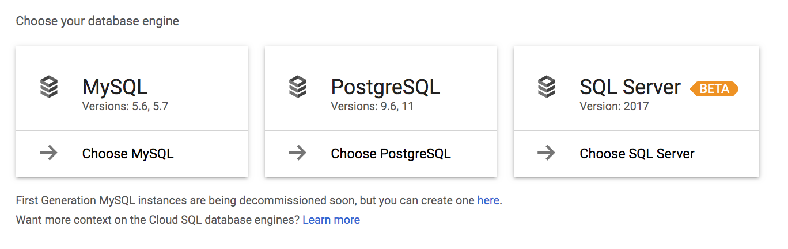
Choose PostgreSQL
Note that other DB options are available, may be useful for final projects?

Slide 50
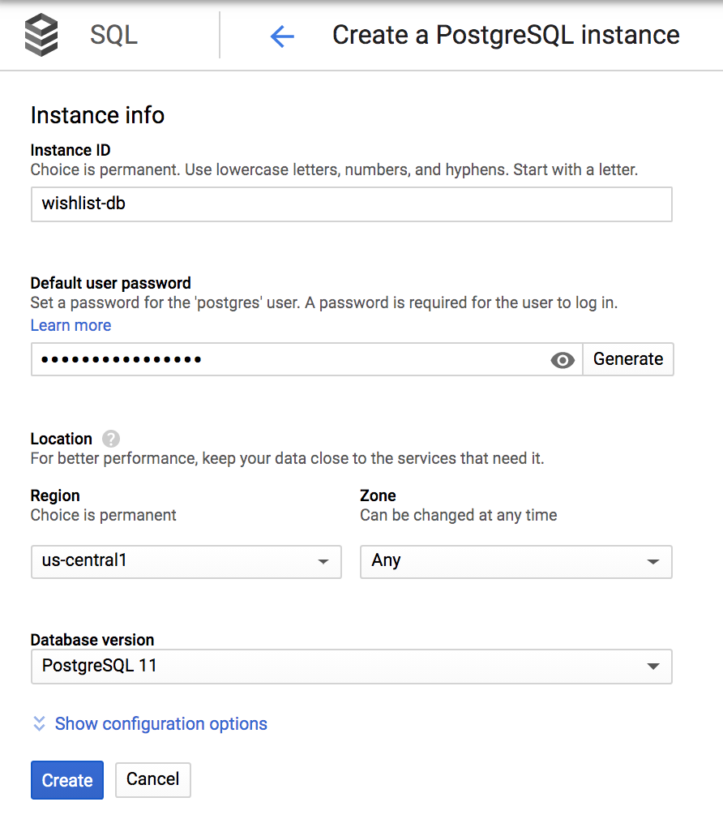
Instance configuration
Set instance name to whatever you like (wishlist-db?)
Set default user password and make a note of it
Use something unique
DON'T use a password you've used elsewhere
Recommendation: the generate button will make a long random password
Verify region is still us-central1
Show Configuration Options

Slide 51
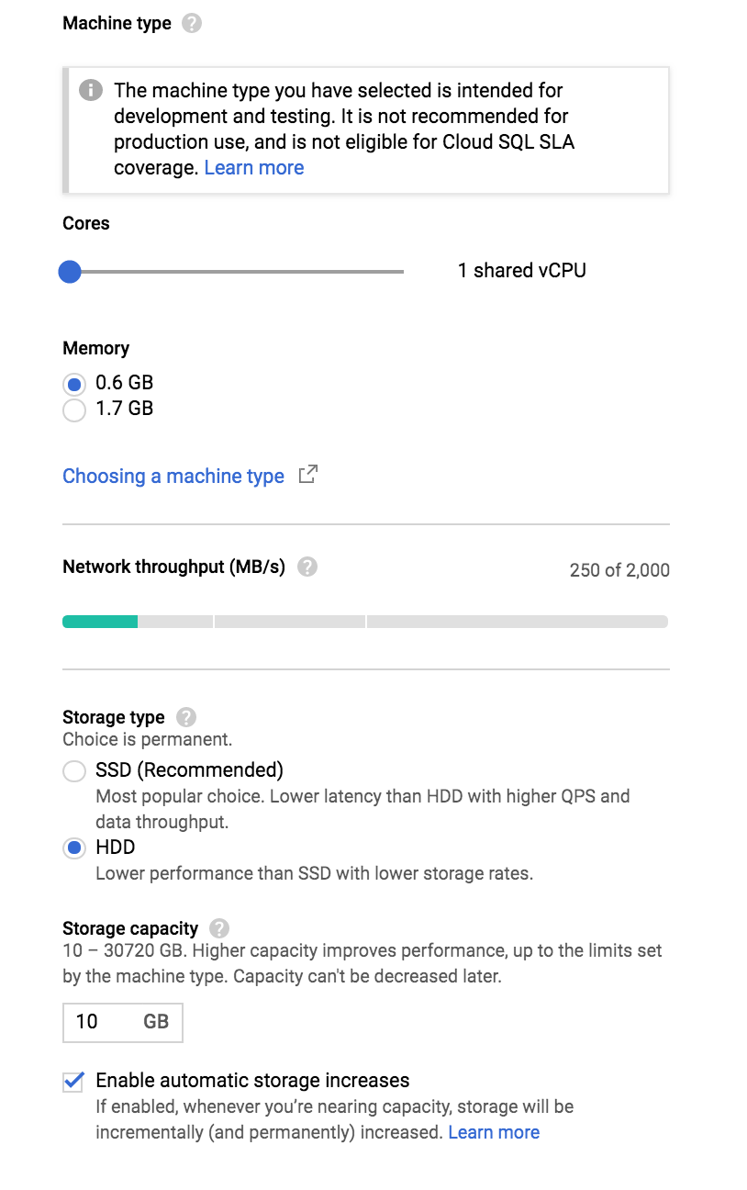
Configuration: to keep costs down
Drag this slider to the left
Lowest values for Cores, Memory
Drag the Cores slider beyond the left stop to set it to 1 shared CPU
OK for development, probably not enough for deployed service
Memory 0.6GB
HDD not SSD
Storage capacity: minimum value
Uncheck Enable automatic storage increases

Slide 52
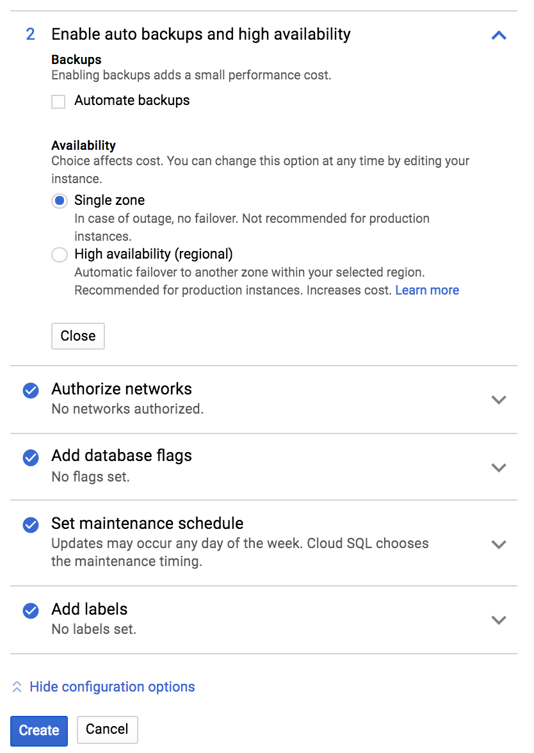
Configuration: to keep costs down
Uncheck automate backups
Single zone availability
Click Create

Slide 53
Configuration: development vs production
You'd make different choices for a production site
For development, we care most about getting it working
Any of the database settings can be upgraded to production-suitable choices (for example, more vCPUs, enable backups) once the site goes live to customers, no changes needed to code
Configuration choices are going to depend on the needs of the site, and your budget

Slide 54
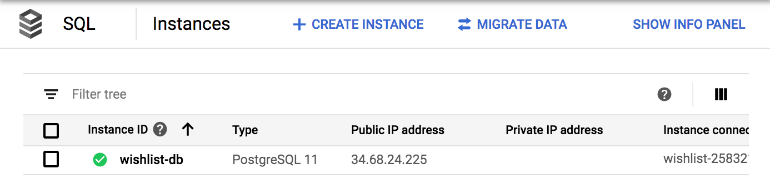
Instance created - it make take a few minutes
This is your database server
Click on the instance ID

Slide 55
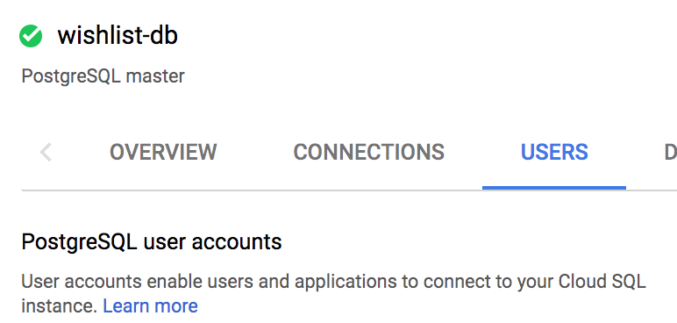
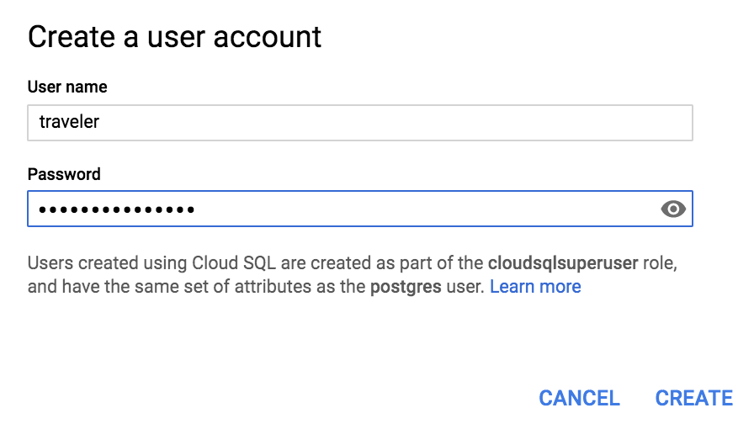
Click on the USERS tab
The web app needs a user account to connect to the Postgres database
Why not use the root user account we just created?
In the Users tab,
Click Create a user button
Name = traveler, use a strong password. You'll type in in plain text in a configuration file so don't use a password you use anywhere else!
Remember the password
Click Create
Come back to this screen if you forget the password or want to change it

Slide 56
DB Users
Other GCP and non-GCP services may need to connect to this database; each service will most likely use a separate user account
So if you had a utility app that worked with this database, you'd create a separate user account for that app
Makes maintenance, monitoring, and access control much easier

Slide 57
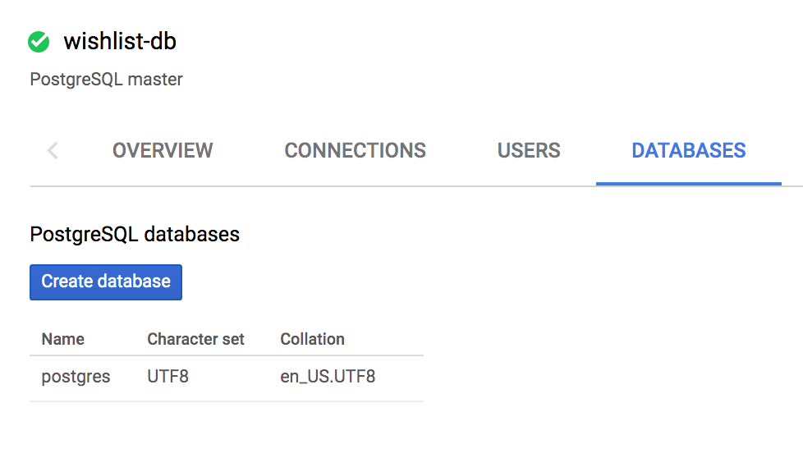
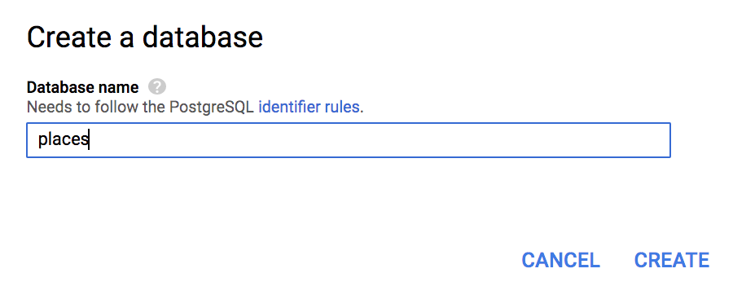
Create Database
Click on the Databases tab
Click Create database button
Create a database called places

Slide 58
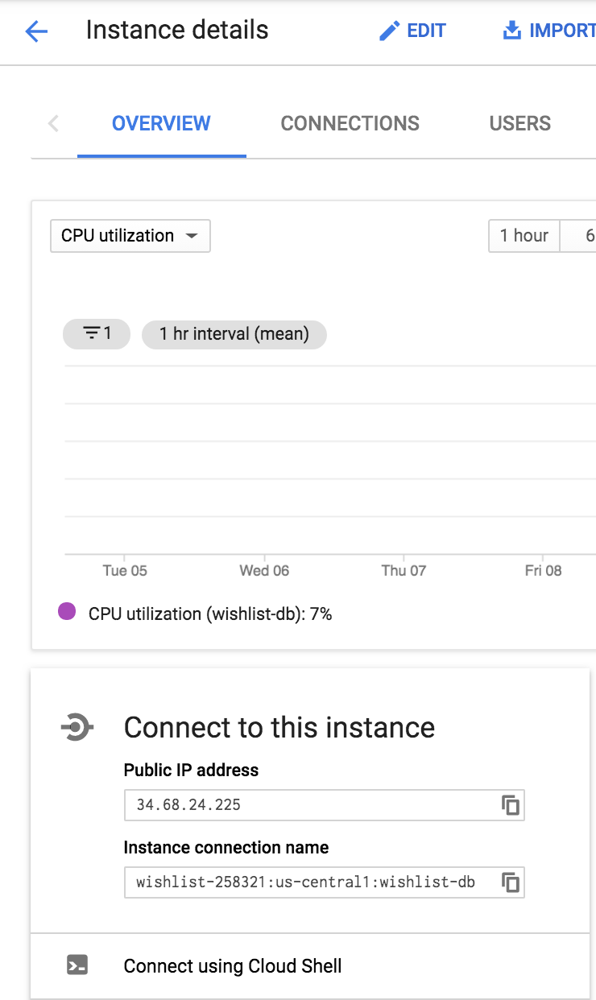
Connecting local app to DB
In the Instance Details page for your DB instance, make a note of the the instance connection name

Slide 59
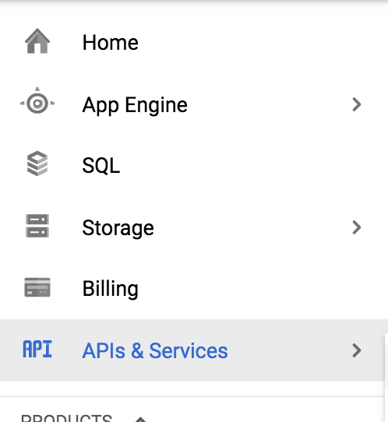
Enable Cloud SQL APIs
Select APIs and Services Click Enable APIs and Services

Slide 60
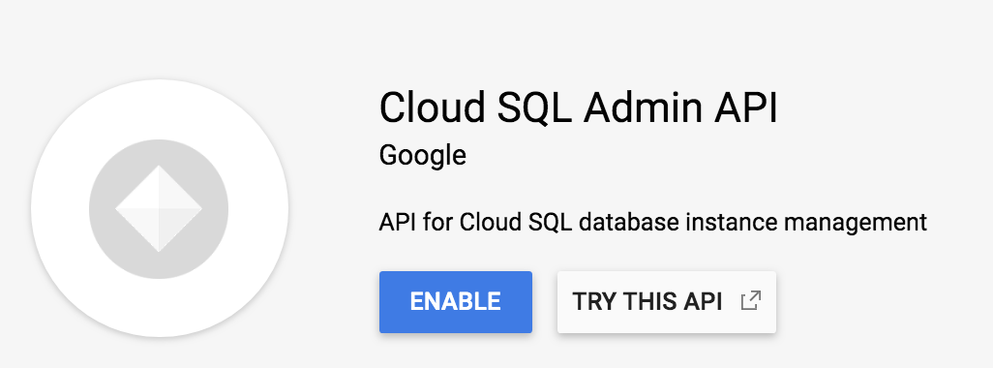

Search for Cloud SQL Admin API
Select, click Enable

Slide 61
How can we talk to the database? Connecting local app to database
Need the Cloud SQL Proxy to authenticate from your local computer to your PostgresSQL database
Even if a user's DB login and password is correct, by default, the only thing permitted to connect to this database is other parts of your project
Your app will connect to the cloud_sql_proxy, which with authorize on your behalf, and will connect to your database instance
Your computer
GCP
Your local app
cloud_sql_proxy
Your database instance

Slide 62
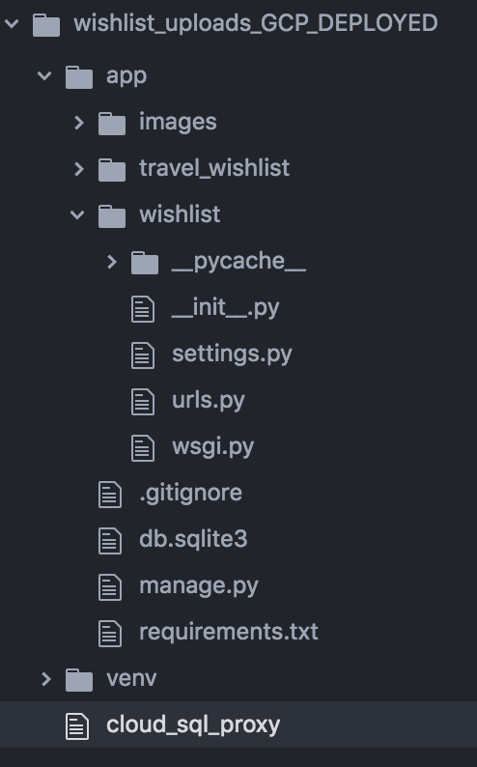
Connecting local app to database
Need the Cloud SQL Proxy, follow install instructions here:
https://cloud.google.com/sql/docs/postgres/quickstart-proxy-test
Mac: use curl to download, make the cloud_sql_proxy file executable
PC: download the cloud_sql_proxy.exe file to your computer
Save this file somewhere convenient on your computer that's in your path

Slide 63
Open another terminal/command prompt Run cloud_sql_proxy
Replace my instance name with yours
Windows: cloud_sql_proxy -instances=wishlist-258321:us-central1:wishlist-db=tcp:5432
Mac: ./cloud_sql_proxy -instances=wishlist-258321:us-central1:wishlist-db=tcp:5432
Should see a "Listening on 127.0.0.1:5432 for your instance name" and "ready for new connections" messages
Leave the cloud_sql_proxy running while your app needs to connect to the cloud DB
Note: to stop the proxy, press Control+C

Slide 64
cloud_sql_proxy troubleshooting
Make sure CloudSQL instance and database have been created
Verify instance name is your own DB
If you have PostgreSQL installed, stop it running
Is the time on your computer correct?
Cloud APIs and Cloud Admin API are enabled
When you try and connect your app, double-check settings.py and your password environment variable

Slide 65
Install Postgres driver
pip install psycopg2
or
pip install psycopg2-binary

Slide 66

Add dependencies to requirements.txt
Everyone: include psycopg2 and gunicorn
Windows users: gunicorn won't work locally on your computer, so no point pip installing it
Mac/Linux: gunicorn will work locally but you probably don't need it, Django's built-in web server is sufficient for running and testing your site locally

Slide 67

wishlist/ settings.py
Replace the current DATABASES setting on line ~77 with this,
Use your own database instance name for the host
Should be '/cloudsql/your-instance-connection-name'
This will be /cloudsql/your-instance-name

Slide 68
Set TRAVELER_PW environment variable
For example, if your password was kittens, run the command in the terminal/command prompt that you will run your app from,
Mac:
export TRAVELER_PW=kittens
PC:
set TRAVELER_PW=kittens
Put quotes around your password if it has spaces in
Don't use kittens as your real password

Slide 69
wishlist/settings.py
One piece of code has to do different things depending on environment it is running in: locally in development or deployed to production
Configure settings.py to connect
To the cloud proxy when your app is running locally
Directly to the instance when deployed
GAE creates a few environment variables for your app, including one called GAE_INSTANCE
So if this environment variable exists, then our app must be running on GAE
Unless you happened to create a local environment variable called GAE_INSTANCE, but don't do that
Real apps might have more environments: development, testing, staging, deployed...

Slide 70

Migrations for the cloud DB
Ensure the cloud proxy is running, and in another terminal, run
python manage.py makemigrations
python manage.py migrate
Remember "Migrations" describes SQL that should run to create appropriate tables for your models
makemigrations examines your models and figures out what SQL needs to run
migrate: executing that SQL to create the tables needed

Slide 71
Make a new user account for logging into the site
We've switched databases
The PostgreSQL DB has no user information
With the cloud_sql_proxy running, create a new user,
python manage.py createsuperuser
Verify site is still working, you'll need to log in first
No login form for this project because we don't want just anyone to sign up to the live version. Have to create users through the admin console.
LMN/Project 5 does have a login form.

Slide 72

Verify app is working locally
Should still be working
Why is it slower?

Slide 73


Create app.yaml
Create this file in the root directory of your application - same place as manage.py
Add this text
Use your instance name
Use your DB password

Slide 74
collect static files
python manage.py collectstatic
If you've run this before, you'll need to press Y to overwrite old static files

Slide 75

Allowed Hosts: wishlist/settings.py
Use your own app ID
Add localhost too

Slide 76

.gcloudignore
Copy the .gcloudignore file from the last project
Specifies files that won't be uploaded to gcloud
Should be in the same location as manage.py, requirements.txt

Slide 77

.gcloudignore
Add a line at the end with the name of your virtual environment
Also add names of any IDE directories, for example, .vscode or .idea
GCP will install the requirements from your requirements.txt so you don't need to upload your virtual environment
Add cloud_sql_proxy if it's in your code directory

Slide 78
Save and deploy
From the same directory as app.yaml, run
gcloud app deploy
Verify you are deploying to the correct app, if not, run
gcloud config set project your-project-name-12345

Slide 79


gcloud app deploy: select region
As before, select us-central
Something to watch while you wait.... https://www.youtube.com/watch?v=XZmGGAbHqa0

Slide 80


Deployed app - no stylesheets
Site should be running
No stylesheets, except Sakura

Slide 81

Errors? Viewing logs
https://console.cloud.google.com/logs
Press Play button to start streaming logs

Slide 82
Bucket
Separate concerns: web app and static files
Can server files faster, and more efficiently, with a dedicated service
Use two Storage Buckets
One for the application's files: JS, CSS, images that are part of the app e.g. logos, background images, icons, decorative images used by the site, any other static resources: refer to these as static files
One for images uploaded by the app's users. Refer to these as media files

Slide 83

Google console - view buckets
Open the Storage console

Slide 84

Verify bucket exists for app's static files
After deploying, you will have a new bucket with a name like
instance-name-12345.appspot.com
You may see some other buckets. Staging contains logs, artifacts contains the container image - the code - for your app.

Slide 85


Gather static files (js, CSS, site images)
python manage.py collectstatic
All of the site's JavaScript and CSS files are moved to www/static directory

Slide 86


Collecting Static Files
Django command to gather static files - so CSS, JavaScript, images used by your app - in one place, for convenient uploading to a bucket
python manage.py collectstatic
To make a copy of all static files in the www directory
This directory name is specified in the STATIC_ROOT variable in settings.py
Confirm your have this line, at the end of wishlist/settings.py
Note: the next time you run this, you'll need to Type "yes" to copy all static files to the www/ directory, because it overwrites the existing content

Slide 87
Upload static files to static files bucket
gsutil -m rsync -r ./www gs://<your-bucket-name>
For example:
gsutil -m rsync -r ./www gs://strong-province-113523.appspot.com/
Run this command from the root directory of your project, use your bucket name
It will upload everything from the www directory to the bucket specified
Most of the files are the JS and CSS for the admin console
gsutil reference https://cloud.google.com/storage/docs/quickstart-gsutil

Slide 88

Verify files uploaded
Should see new files in your project-id.appspot.com bucket

Slide 89

Set Permissions
Bucket files are private by default
Click on permissions
In New members, type allUsers
Role is Storage Object Viewer
Click Save

Slide 90

Modify settings.py
Change the end of settings.py, add last two lines
Tell your app to look in your bucket for static files
Use your bucket name

Slide 91


Redeploy your app with the new settings.py
gcloud app deploy
Press Y to deploy
Wait... check site
All styles present, and are you sure JavaScript when deleting a place

Slide 92
Serving static files from bucket, not app engine
Cheaper, faster, more efficient
Buckets are designed for serving static files quickly and efficiently
GAE is optimized to run application code

Slide 93
Updating static files
If you need to modify a static file, you don't need to redeploy your app
Just upload it to the bucket with these two steps
Run python manage.py collectstatic
Upload the new version to the bucket with the gsutil tool
gsutil -m rsync -r www gs://YOUR-APP-BUCKET.appspot.com/

Slide 94

Storage - create bucket for media (user uploaded files)
Click Create Bucket

Slide 95

Create bucket for app's media files (user image uploads)
I called mine
user-place-images
You'll need to pick another name - they must be unique
Make a note of the name

Slide 96

Creating bucket for app's media files (user image uploads)
Location type = region
Location us-central1

Slide 97

Create bucket for app's media files (user image uploads)
Default storage class Standard

Slide 98

Create bucket for app's media files (user image uploads)
How to control access: select Uniform
Click Continue, and Create

Slide 99

List of Storage Buckets
Should look something like this

Slide 100
Static files vs. application resources when deployed
GCP Project
Client
I need to talk to the database to get the data to make this page
happy-zebra-123.appspot.com/place/9
Give me the page for place 9
Now to display the page
Here's the HTML page
It's got links to some static resources
App Engine
Cloud SQL
Sakura CDN
There's a CSS link, must request this
And another CSS link
And a site image link
And a user image link
And a JavaScript link
....
Bucket: app static files
Bucket: user uploads static files

Slide 101

HTML will look like then when deployed. Spot the links to buckets, Sakura CDN

Slide 102
Difference between serving static files and application responses (HTML pages)
Browser requests page from App Engine
App Engine talks to Cloud DB, generates response - typically HTML page with links to any static resources
The static resource href and src links point to the storage buckets (in Sakura's case, the Sakura CDN)
When browser receives HTML response page, it reads the HTML and starts displaying the page in the user's browser
As the browser finds links to static resources, it makes another request for each static resources
These links point to the a bucket, so requests form images. CSS etc. are sent to the bucket (and for this app, Sakura)
The client can then display the complete page
App Engine app only provides the appropriate link, it doesn't serve the resource

Slide 103

Install two libraries to manage media storage
http://django-storages.readthedocs.io/en/latest/backends/gcloud.html
These connect Django to the GCP bucket
Install with
pip install django-storages
pip install google-cloud-storage
Add to requirements.txt

Slide 104

wishlist/settings.py: use buckets
Add last three lines
Use your own bucket names
Replace my names with your bucket names

Slide 105

Set read permissions for media files
In the user images bucket, click in Permissions

Slide 106

Set read permissions on static and media files
Edit bucket permissions
Click Add Members
New members: allUsers
Role = Storage Object Viewer
Save

Slide 107
Deploy your app
Apply the new requirements and settings with
gcloud app deploy

Slide 108

Download credentials file for user-place-images bucket
Select APIs and Services > Credentials

Slide 109

Create Credentials
Select Service account key

Slide 110

Select App Engine service account
Select JSON for the key type
Click Create

Slide 111


Download json file to your project
Save in the root directory of your project
Add the credential filename to .gitignore - do not upload to GitHub!

Slide 112
settings.py
Configure credentials, add to settings.py
Use your own file name
Redeploy

Slide 113


Verify working locally
App should connect to the GCP database via the sql_cloud_proxy
Upload a test image for an example place
User images should be uploaded to, and served from, the user-place-images bucket
Static files served from the your-app-name-12345.appspot.com bucket
Verify by looking at the HTML page source

Slide 114

wishlist/settings.py: for local and deployed environments
Again, watch the environment variable name

Slide 115
Deploy
gcloud app deploy
Deployed app should be working

Slide 116

Deployed version: ensure everything is working
Static files CSS and JS
background color of header should be present
Add, you should be able to add/create/delete/view with places in DB
Should be able to upload images
Images saved in bucket

Slide 117

Set DEBUG in settings.py
What happens if you go to a page that doesn't exist?
Development version (DEBUG=True in settings.py) shows a stack trace in the event of an error
Production version should not do this - instead, show a generic 404 or 'Sorry something went wrong' page.
Why?

Slide 118

Final settings.py - once everything is working
If running on GAE, set debug = False
If local, debug = True

Slide 119

DEBUG = False
Redeploy gcloud app deploy
Go to a page that doesn't exist
Verify generic Not Found page
If DEBUG=False, your app will show a Not Found page instead of the stack trace/error message page
Locally, will still see the stack trace/detailed error message

Slide 120
Optional - final settings
Suggested: replace secret key with a new, random key
Generate a new key and redeploy
Script from https://gist.github.com/ndarville/3452907

Slide 121
Checklist
App runs when deployed
Generic 404 page
User can upload images
User images stored in user-place-images bucket
Static files served from your-app-name-1234.appspot.com

Slide 122
Finishing Up, Lab, and Cleanup
**** Please show me your app running for credit for this lab ****
You may delete this project to avoid being billed - once I've verified your app is working, you may delete it from GAE
Lab/shared computers: run
gcloud auth revoke
to log out of your Google account at the end of your session

Slide 123
GitHub
Should you put app.yaml on GitHub?
Should you put your credentials .json file on github?
Verify that you are ignoring both with .gitignore
You don't need to turn in your code for this lab - remember to demo your app running for me

Slide 124

Billing
Select
Cost before credit
WATCH YOUR BILLING ACCOUNT
Use the reports to you can see what you are using, and what it is costing
Shut down/disable services you don't need
Remember a database or a bucket can still incur charges for existing, even if it is disabled or empty
Reports

Slide 125
Scheduled tasks - cron
cron jobs are used to schedule tasks at app engine
Create a URL in your web app that when POSTed to, runs your task
Create a cron.yaml file that has the interval, and the URL
To do: explore ways to protect your task URL - only the cron job runner should be able to access the URL or only requests made by the cron job runner should be responded to
cron job restrictions - the entire task must complete within 60 seconds
Must deploy your cron file with
gcloud app deploy cron.yaml

Slide 126




Scheduled tasks example
new file, travel_wishlist/admin_views.py
cron.yaml, root directory of project
travelwishlist/urls.py
travel_wishlist/models.py

Slide 127
Finishing Up
Please show me your app running
You may delete Wish List from App Engine
It will cost ~$1 a day to run in this configuration

